Slide 1
Analog Electronics Lab Experiment-2
Lab Instructors:
Ankita Dixit , E-mail:p20170414@pilani.bits-pilani.ac.in
Prem Sai Regalla, E-mail:p20190435@pilani.bits-pilani.ac.in

Slide 2
High Input Resistance Transistor Amplifier (Emitter Follower) Circuits

Slide 3
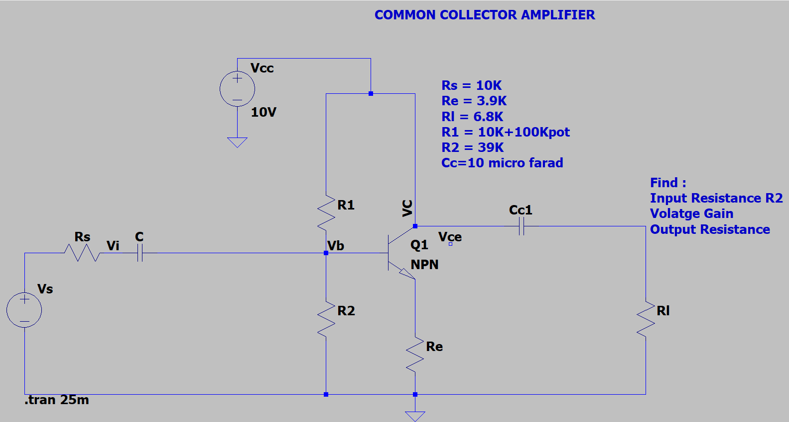
Common-Collector Amplifier Schematic

Slide 4
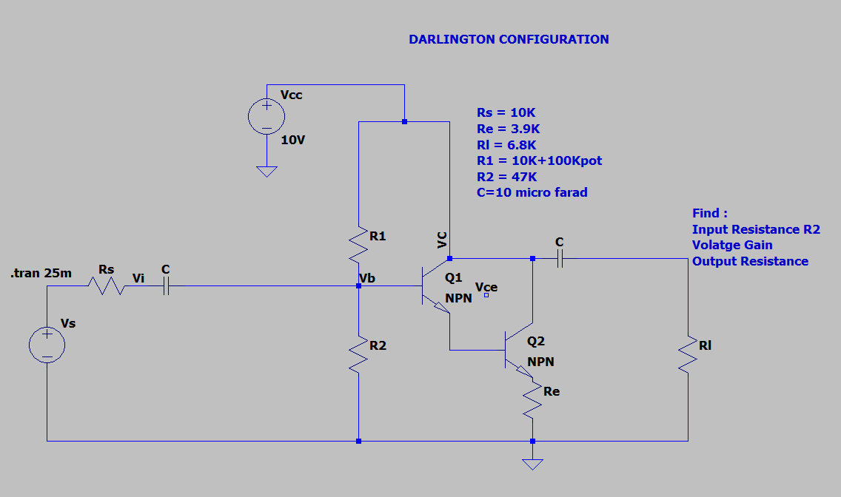
Darlington Mode Transistor Schematic

Slide 5
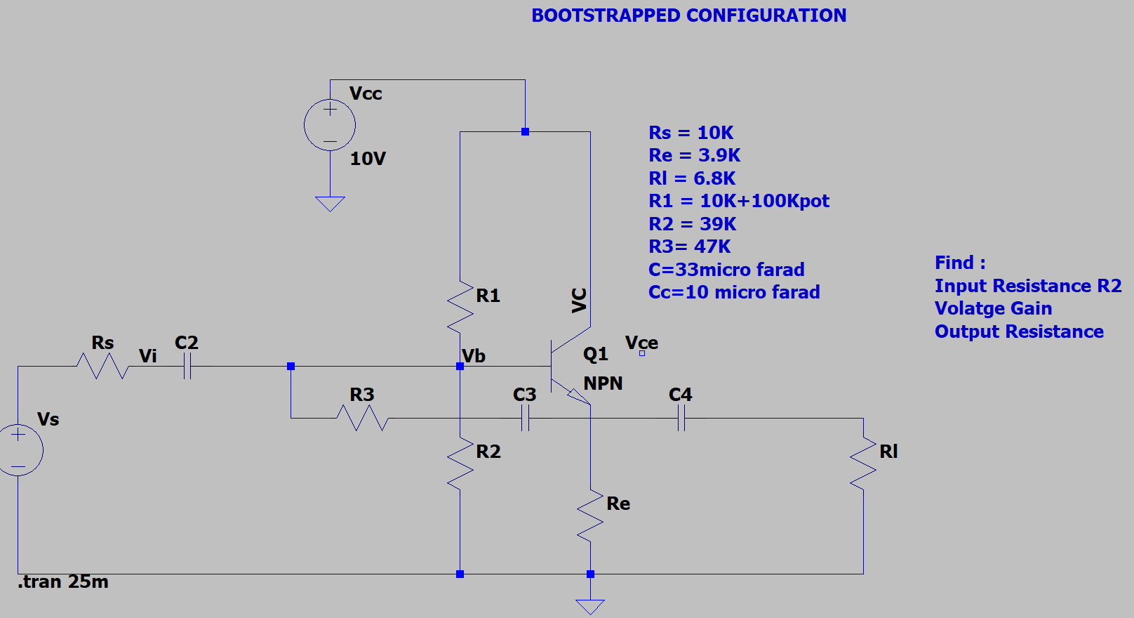
Bootstrapped Emitter Follower Schematic

Slide 6
Assignment:
To study the common-collector amplifier, Darlington mode transistors, bootstrapped emitter follower.
Upload a single PDF file which includes
1)Schematic model :
i) Common Collector amplifier
ii) Darlington mode transistor
iii) Bootstrapped emitter follower
iv) Common collector amplifier for Rl
2)Values of Rin, Rout and Av for all three configurations. Also show the value of I_{in}, V_{in}, I₀,V₀
3) The file name should be your Bits-ID
4) You are required to submit the file on NALANDA latest by5:00 PM (Wednesday, 3/2/21). (2 marks deduction for late submission)

